Slide 1
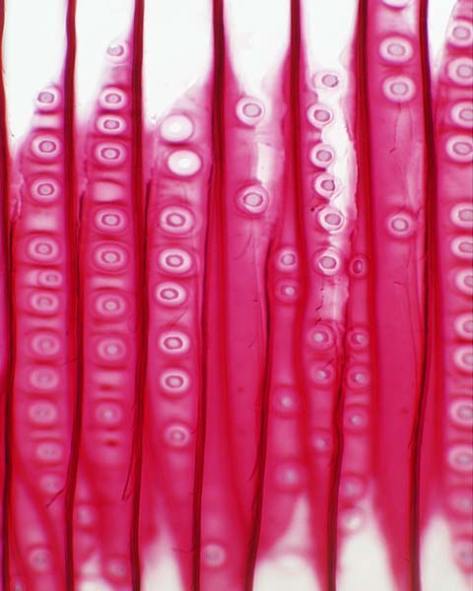
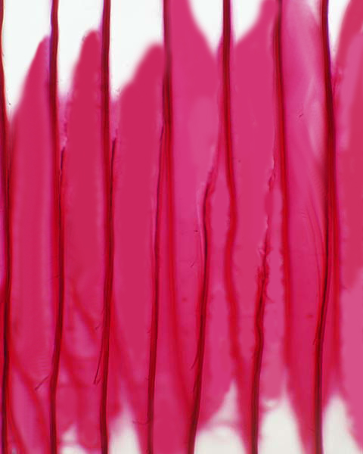
i. Tracheids :
These are long narrow cells with walls that are impermeable to water.
When tracheids mature, they die and their cytoplasm disintegrates.
This leaves a network of hollow connected cells through which water can pass.
Breaks down

Slide 2
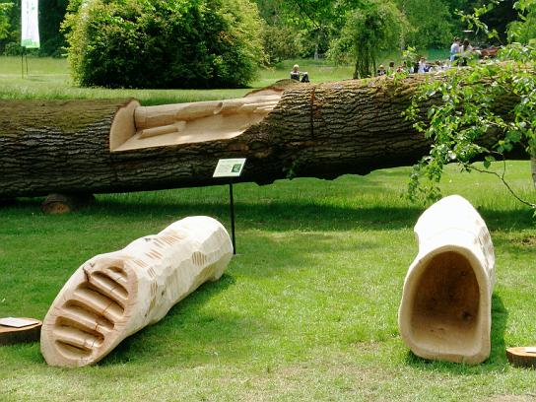
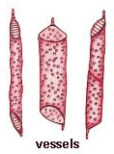
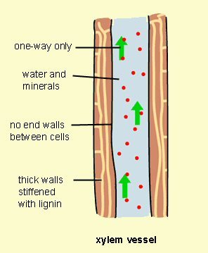
ii. Xylem vessels :
These are tubular structures and are much wider than tracheids.
They are arranged end to end and on top of one another like a pipe line.
The cell walls at both the end degenerate when the cells die.
As a result, the stacked vessels becomes continuous tubes.
This allows free flow of water and minerals in vertical direction.

Slide 3
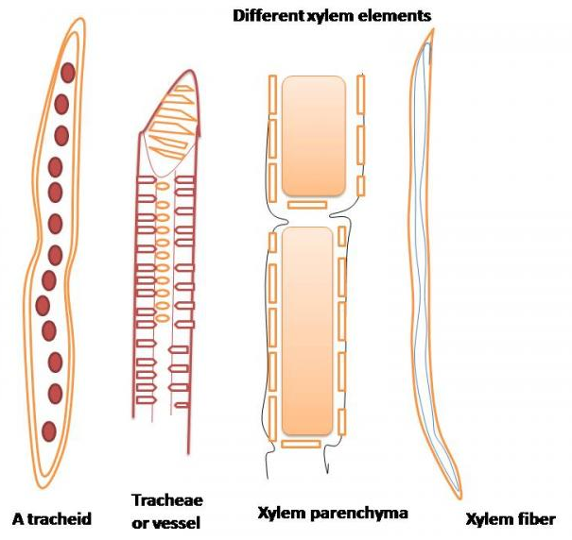
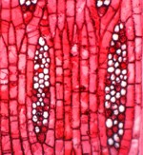
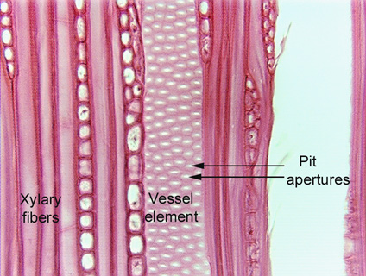
iii. Xylem parenchyma :
Its stores food.
iv. Xylem fibers :
They mainly support the plant.
Xylem parenchyma

